Slide 1

Predicting Housing Sales Price
Presented By:
Aiman Manzoor

Slide 2

Table of Contents
Introduction
Description of the dataset
Assumption’s verification for Ordinary Least Squares (OLS)
OLS Result
PCA and Neural Networks
Comparison
Conclusion

Slide 3

Project Goal
Be familiar with all aspects of the Linear regression model
Learn to use some the ML techniques
compare the performance of different models

Slide 4
Why we care about predicting the housing price?
It is important to:
individual households
investors
governments
Notes:
Housing prices are often used as an indicator of the health of the economy. Increases in housing prices may signal a strong economy, while decreases may signal a weakening economy. Overall, housing prices can have a significant impact on individuals, the economy, and society as a whole, which is why they are an important topic to discuss.

Slide 5

Description of the dataset
The dataset that we have chosen is from Kaggle ( link: House Prices - Advanced Regression Techniques | Kaggle) and is an ongoing competition.
It comprises 79 variables each of which explains different attributes of the house.
Our supervised variable is going to be the sale price of houses, which is continuous in nature.

Slide 6
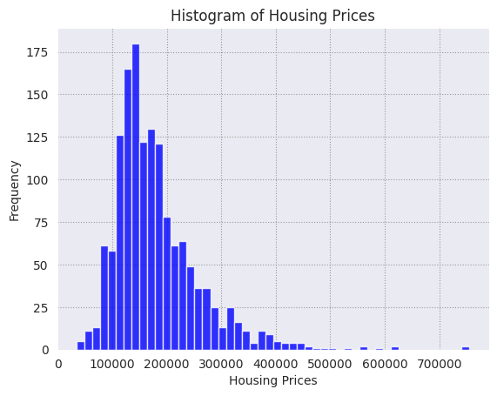
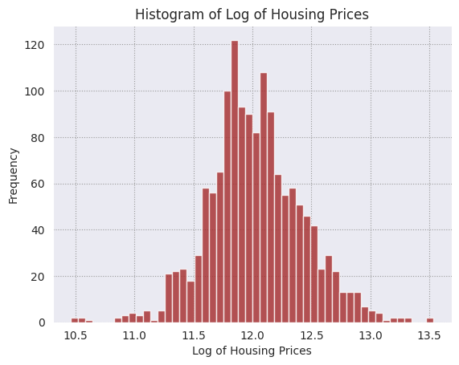
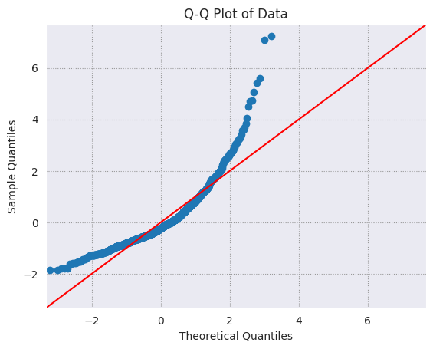
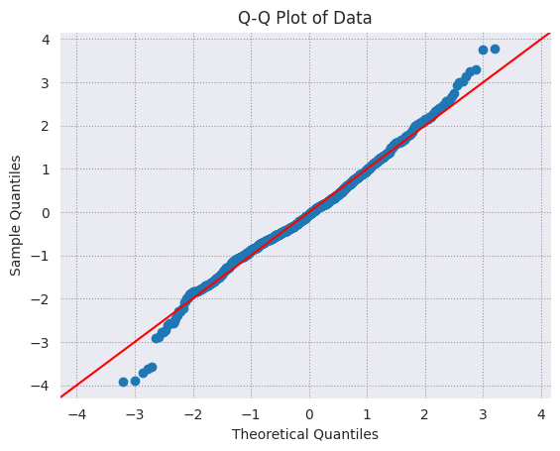
Explanation of the Supervisor
We used the Log of house sales price instead of simple sales price for most of the analysis.

Slide 7
Pre-Processing
We removed the variables with NULL values (19 features)
Separate numerical and categorical variables
One hot encode the categorical data variables into dummy variables
Normalize using z-score so that all the features are within the [0,1] range
Split the dataset such that 70% is used for training and 30% for testing.
Notes:
One point I want to make here is that in linear model if one categorical variable have 3 categories, only two can be included in the model. The rest one will be absorbed in the intercept.

Slide 8
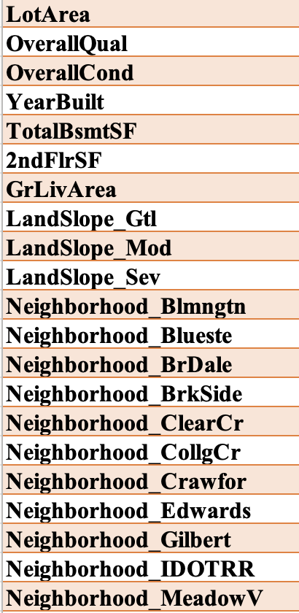
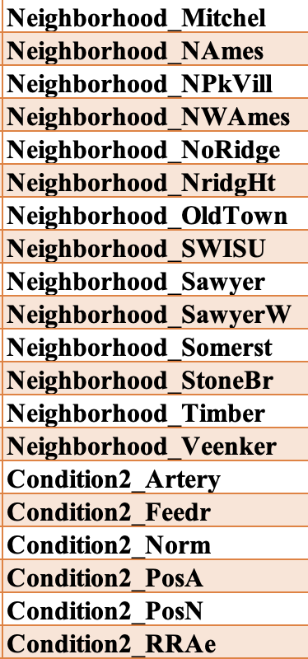
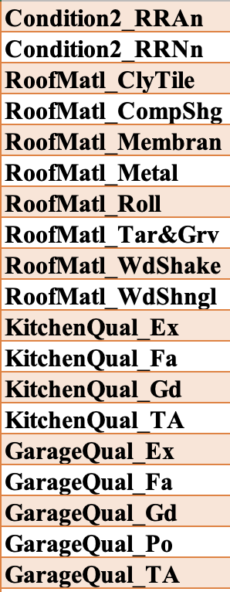
List of Selected Variables
We used Ordinary Least Square Model to predict the most significant variables with p-value lower than 0.0001.
Notes:
6 continuous and 6 categorical

Slide 9

Assumption Verification for OLS

Slide 10
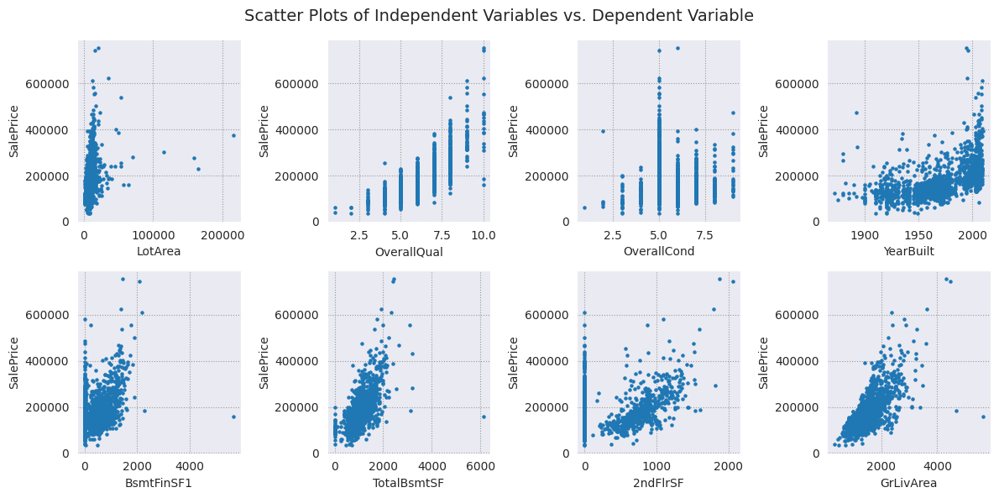
Assumption 1
Linearity: The relationship between the dependent variable and the independent variables is linear, meaning that changes in the independent variables are associated with constant changes in the dependent variable.

Slide 11
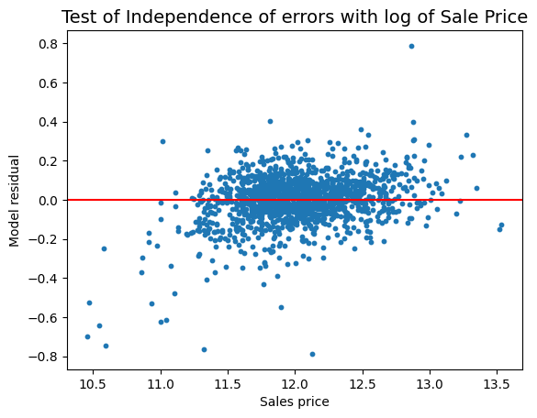
Assumption 2
Independence of errors: The errors or residuals (the differences between the observed values and the predicted values) are independent, meaning that the errors for one observation are not influenced by the errors of other observations.

Slide 12
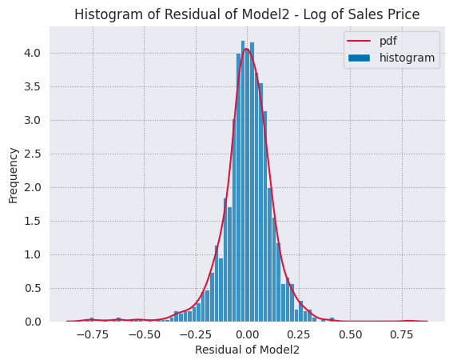
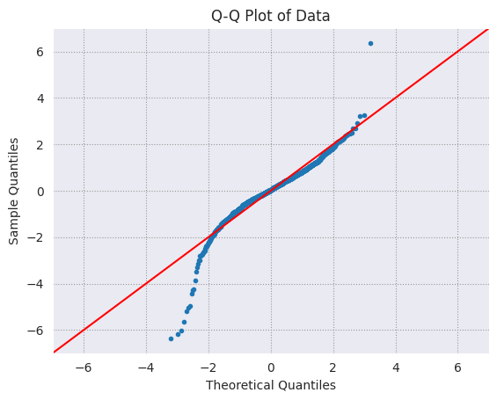
Assumption 3
Normality of errors: The errors are normally distributed, meaning that the distribution of the errors follows a bell-shaped normal distribution.

Slide 13
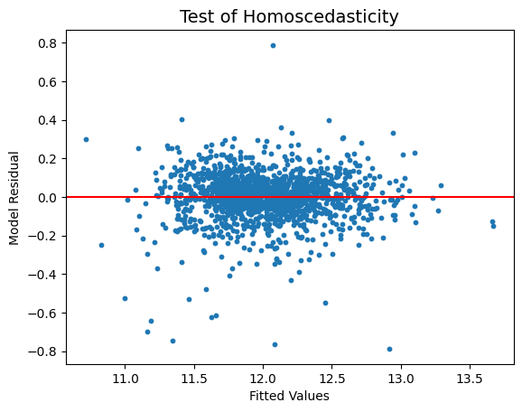
Assumption 4
Homoscedasticity: The errors have constant variance across all levels of the independent variables, meaning that the variability of the errors is the same for all values of the independent variables.

Slide 14
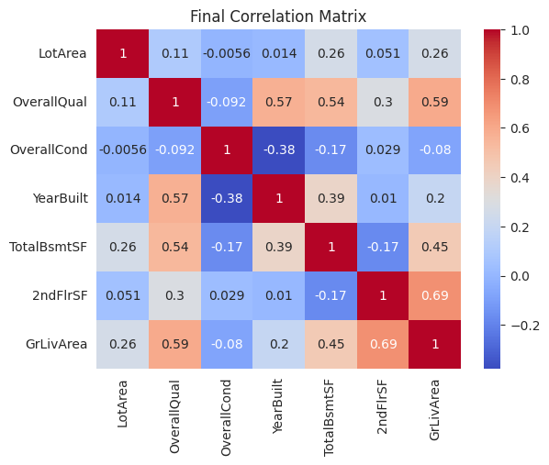
Assumption 5
Multicollinearity: There is no perfect or near-perfect linear relationship among the independent variables, as this can cause issues in estimating the regression coefficients and interpreting their effects.

Slide 15
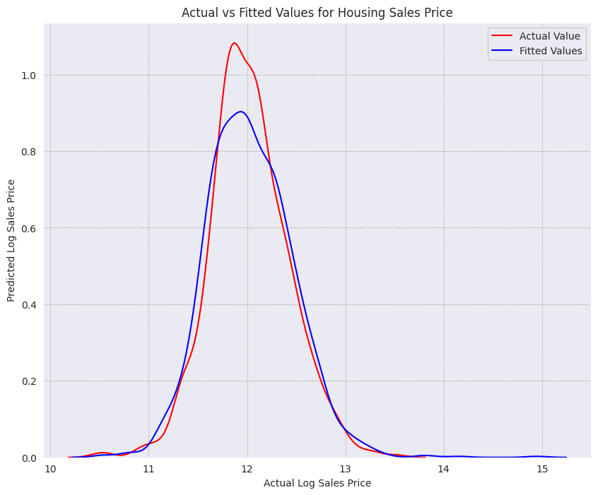
Ordinary Least Square Model Result
R-Squared | 0.897
Mean Square Error | 0.0338

Slide 16

Exploratory Data Analysis

Slide 17
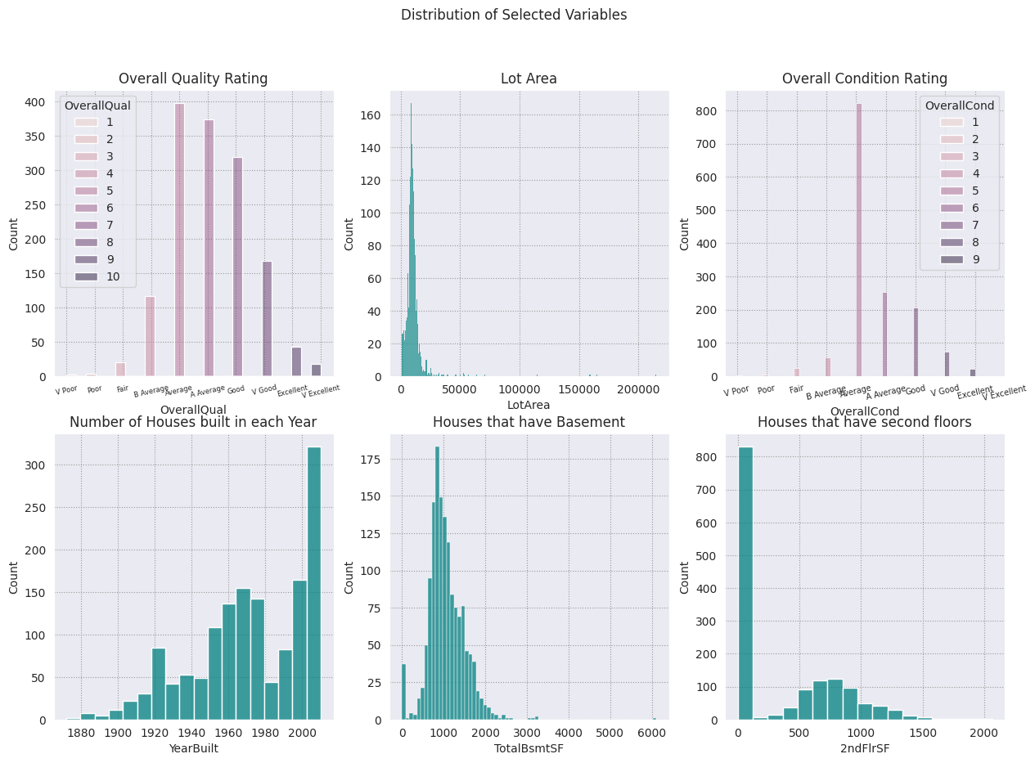

Slide 18
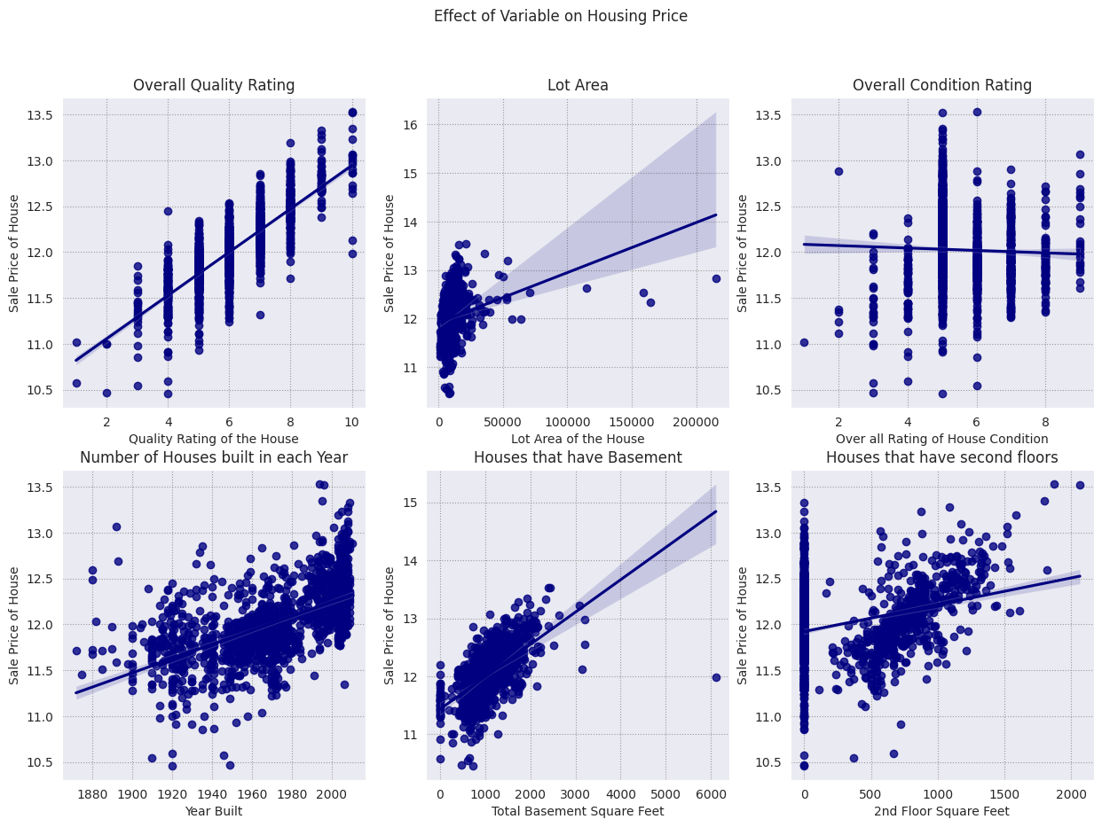

Slide 19

Regression Models

Slide 20
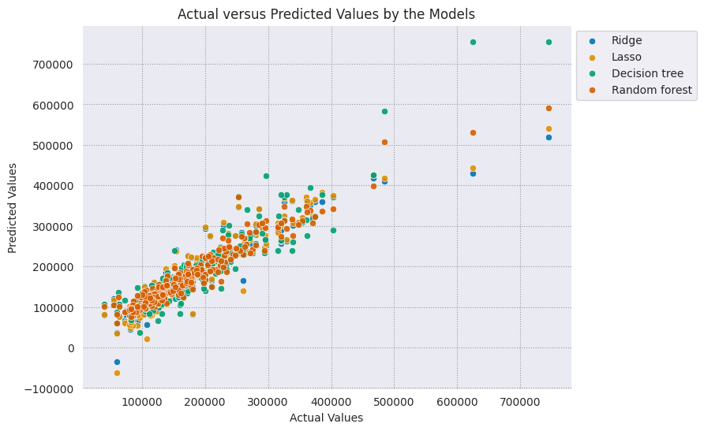
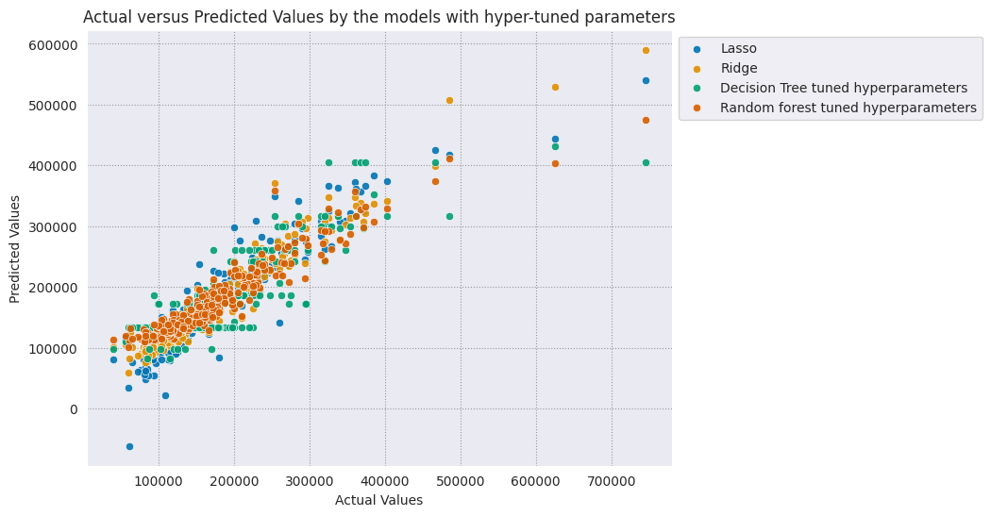
Regression Model Results Without and With Hyper-Tuned Parameters
Notes:
The models that we used are as follows:
Lasso
Ridge
Decision Tree
Random Forest
We used Hyper Tuned Parameters for each of the algorithms
For Lasso and Ridge we choose the alpha value which would improve the result the most
For Decision Tree we used the feature of max_depth and max_features
While for Random Forest we also added the n_estimators feature.
The graph for hypertuned parameters shows a more steeper result, and we see that random forest performs the best amongst all the other models.

Slide 21
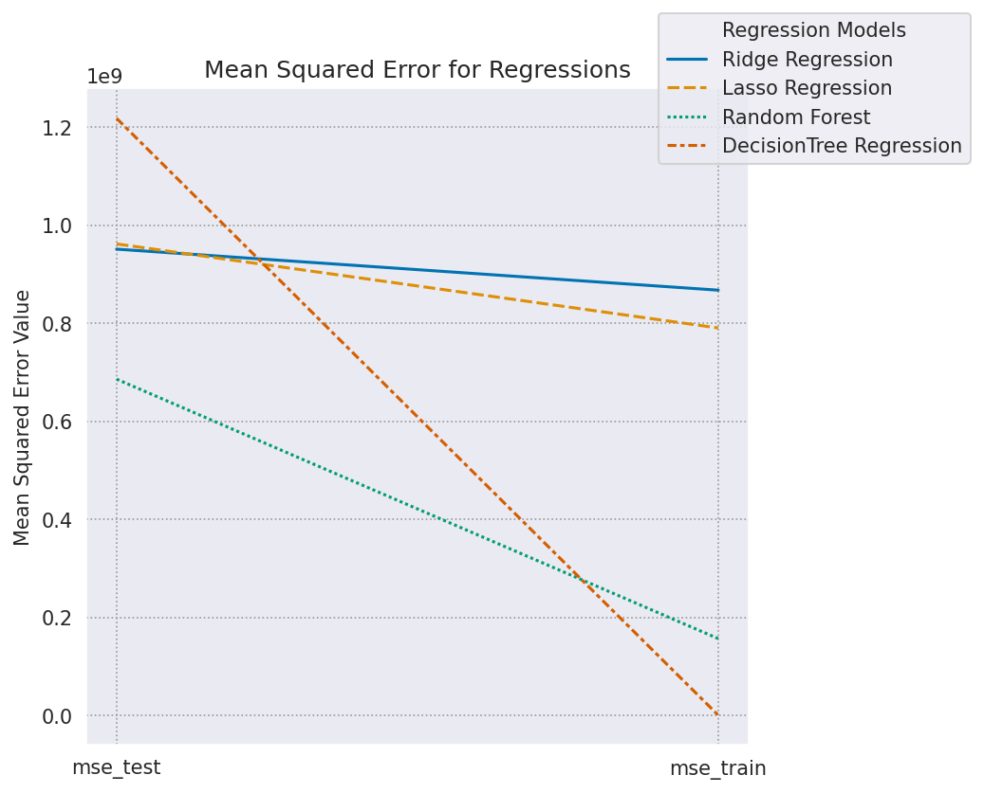
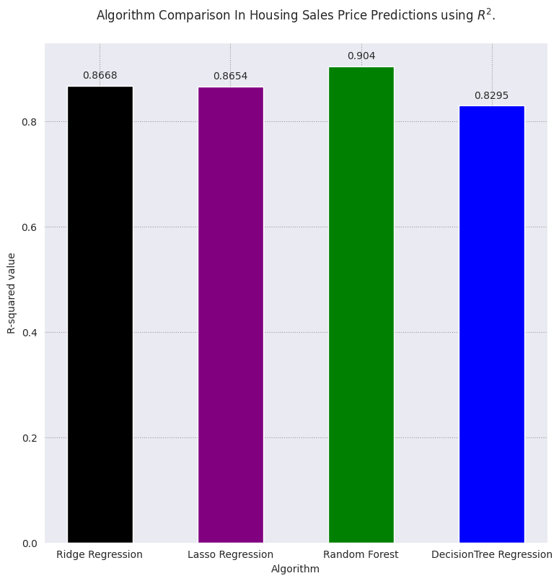
Comparison between test and train (MSE And R-Squared)
Notes:
On the left we have the model that compares the Mean Square error for all the models. We can see that Random Forest reduces the mean squared error the most. Whereas, Decision Tree ends up overfitting the model which is an issue which the model suffers from when the supervisor is of continuous nature and also that the model has a high variance and low bias due to its nature. The R-square also shows that Random Forest performed the best amongst all the other models with the value of 90.4%.

Slide 22
PCA (Principal Components Analysis)
Advantage:
1. By reducing the dimensionality, the PCA will consider all continuous variables.
2. By producing principal components, PCA will address the collinearity issue in the dataset.
Disadvantage:
Low interpretability.
Previous approaches are based on training data, but the data normalization and transformation for PCA are based on the combined dataset. In other words, the principle components may not represent the maximum variation for training dataset.

Slide 23
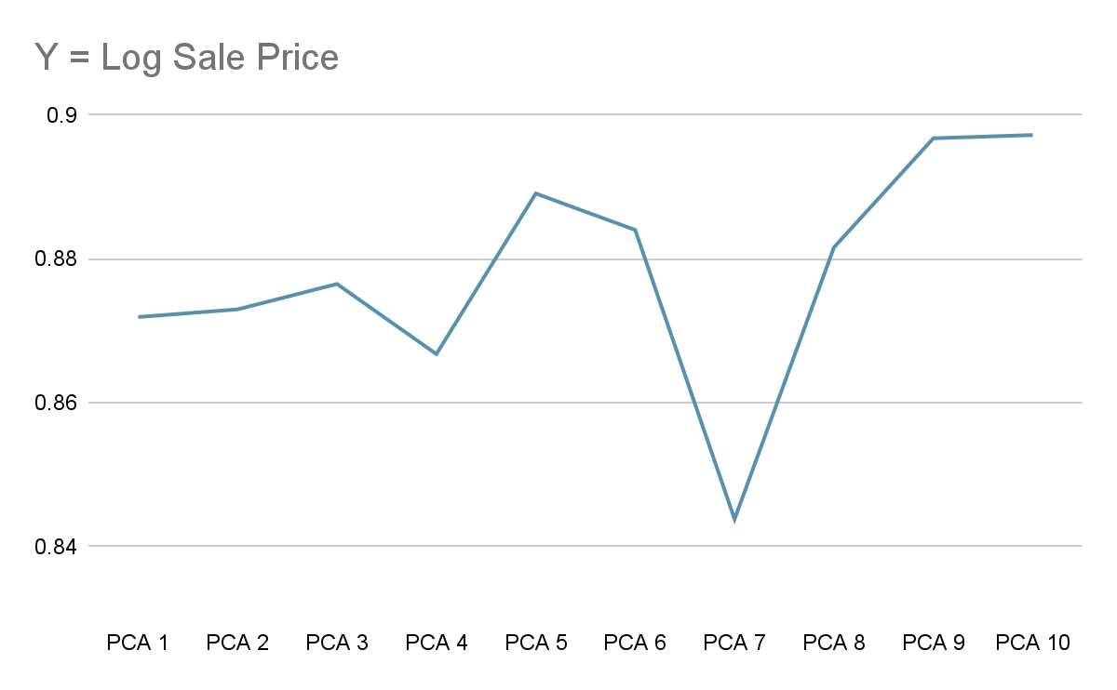
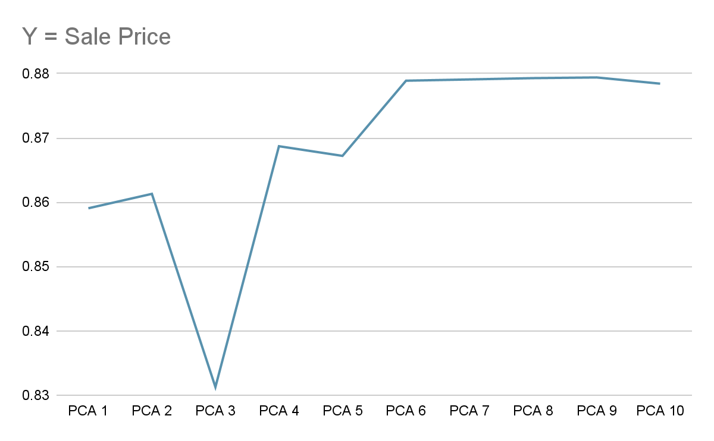
PCA Performance

Slide 24
Neural Network
Advantage:
1. Neural network has the capacity to consider all variables, both continuous and categorical.
Disadvantage:
Low interpretability.
We need to split the training data to training, validation and test data by 0.6-0.2-0.2. This effort further reduce the amount of data we can use for training tasks.
With a small sample size for training, our L2 regularization (similar to Lasso regression) and dropout effects are large, which reduces the ability for model to fit the dataset.

Slide 25
Neural Network Performance
Performance based on the test data. (Random 20% of the training data)
Various Models were checked, with the best performer bing:
Input Dense Layer with 256 Neurons - Dense Layer with 256 Neurons - Dropout(rate = 0.3) - Output
Data are normalized before running.
Performance are tested on unseen test data, R2 could reach 0.89 for both price and log price.
There are still room for improvement.

Slide 26
All Model Performance Comparison
 | Metric | Linear Model (All Variables) | Linear Model (6 continuous and 6 categorical) | Ridge Regression | Lasso Regression | Random Forest | Decision Tree | PCA | Neural Network
Y = Sale Price | R2 | 0.934 | 0.872 | 0.867 | 0.865 | 0.904 | 0.829 | 0.879 | 0.892
 | MSE | 5.1 * 10^8 | 8.4 * 10^8 | 9.5 x 10^8 | 9.6 x 10^8 | 6.9 x 10^8 | 1.2 x 10^9 | 7.6 x 10^8 | 6.3 x 10^8
Y = Log Sale Price | R2 | 0.946 | 0.897 | 0.893 | 0.773 | 0.818 | 0.765 | 0.897 | 0.887
 | MSE | 0.0106 | 0.0171 | 0.0179 | 0.038 | 0.031 | 0.039 | 0.0164 | 0.020
Interpretability |  | Yes | Yes | Yes (but less) | Yes (but Less) | No | No | No | No
Robustness |  | Low | Middle | High | High | High | High | Middle to Low | High

Slide 27
Conclusions
The best performance model winner: Neural Network, Random Forest and PCA
Linear Model’s performance is not much different from other machine learning and deep learning models, while the interpretability is much higher
Based on the coefficients of linear model, here are some tips for your homes (Y is Log):
The housing condition (beta = 0.055) is almost equally important to housing quality(beta = 0.063) in determining the housing prices, so maintain your home well.
Although statistically significant, the impact of housing age on prices are small (beta = 0.0033)
Roof material has a very significant impact on housing prices (beta ranging from beta = -2.1 (Clay or Tile) to 0.84(Metal) and 0.77 (Membran)

Slide 28
Thank you!

